Slide 1
DFA Submission South African Copyright Act changes
rehad desai, Marc ScwInges
& Izette mostert
Notes:
The Documentary Filmmakers’ Association (DFA) was established in 2006, to nurture and develop the interests of documentary filmmakers in South Africa.
Three of us are Documentary filmmakers and not legal professionals. We Volunteered to this kind of work.

Slide 2
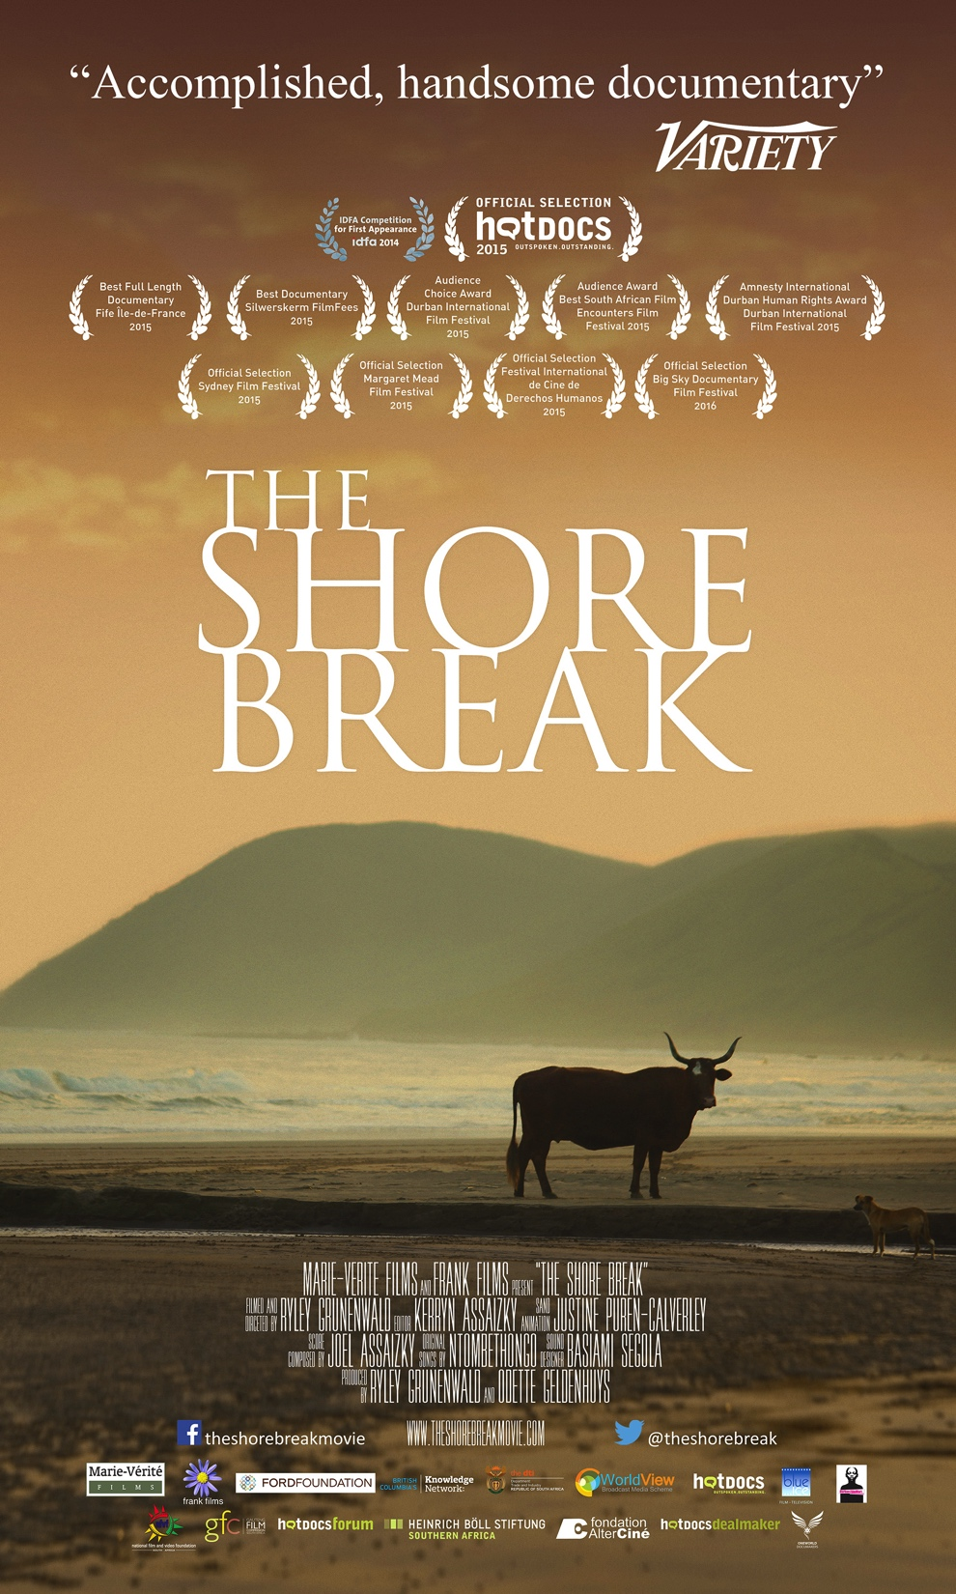
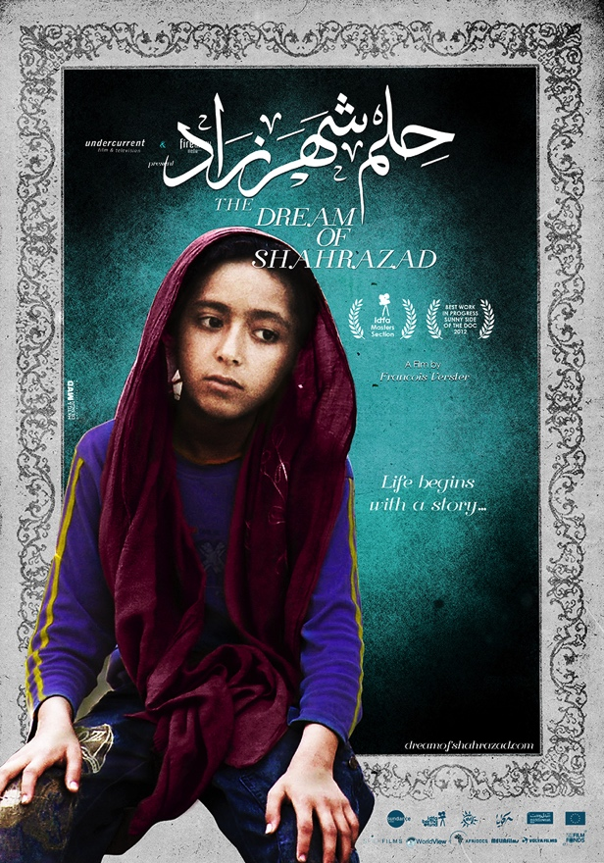
Notes:
The documentary film genre is unique. It stimulates public discourse, reflects on social, …

Slide 3

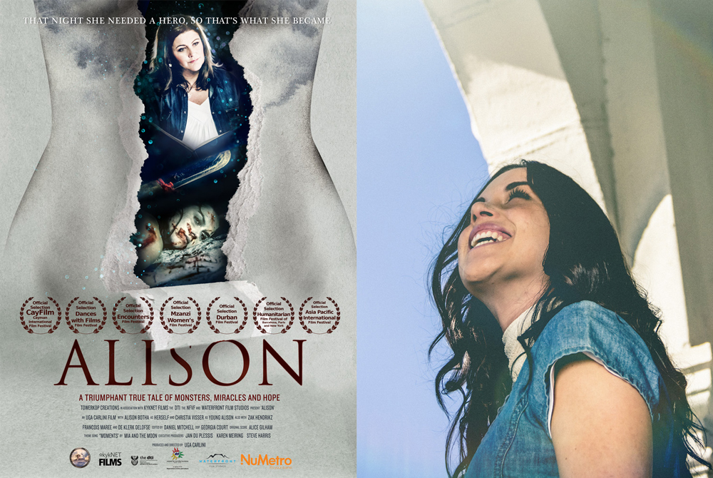
Notes:
political, cultural and current events, explores history, commemorates heritage and unearths the mysteries of the universe and the planet. Documentaries tell stories of ordinary and extraordinary people and communities – they celebrate, question, investigate and reflect.

Slide 4

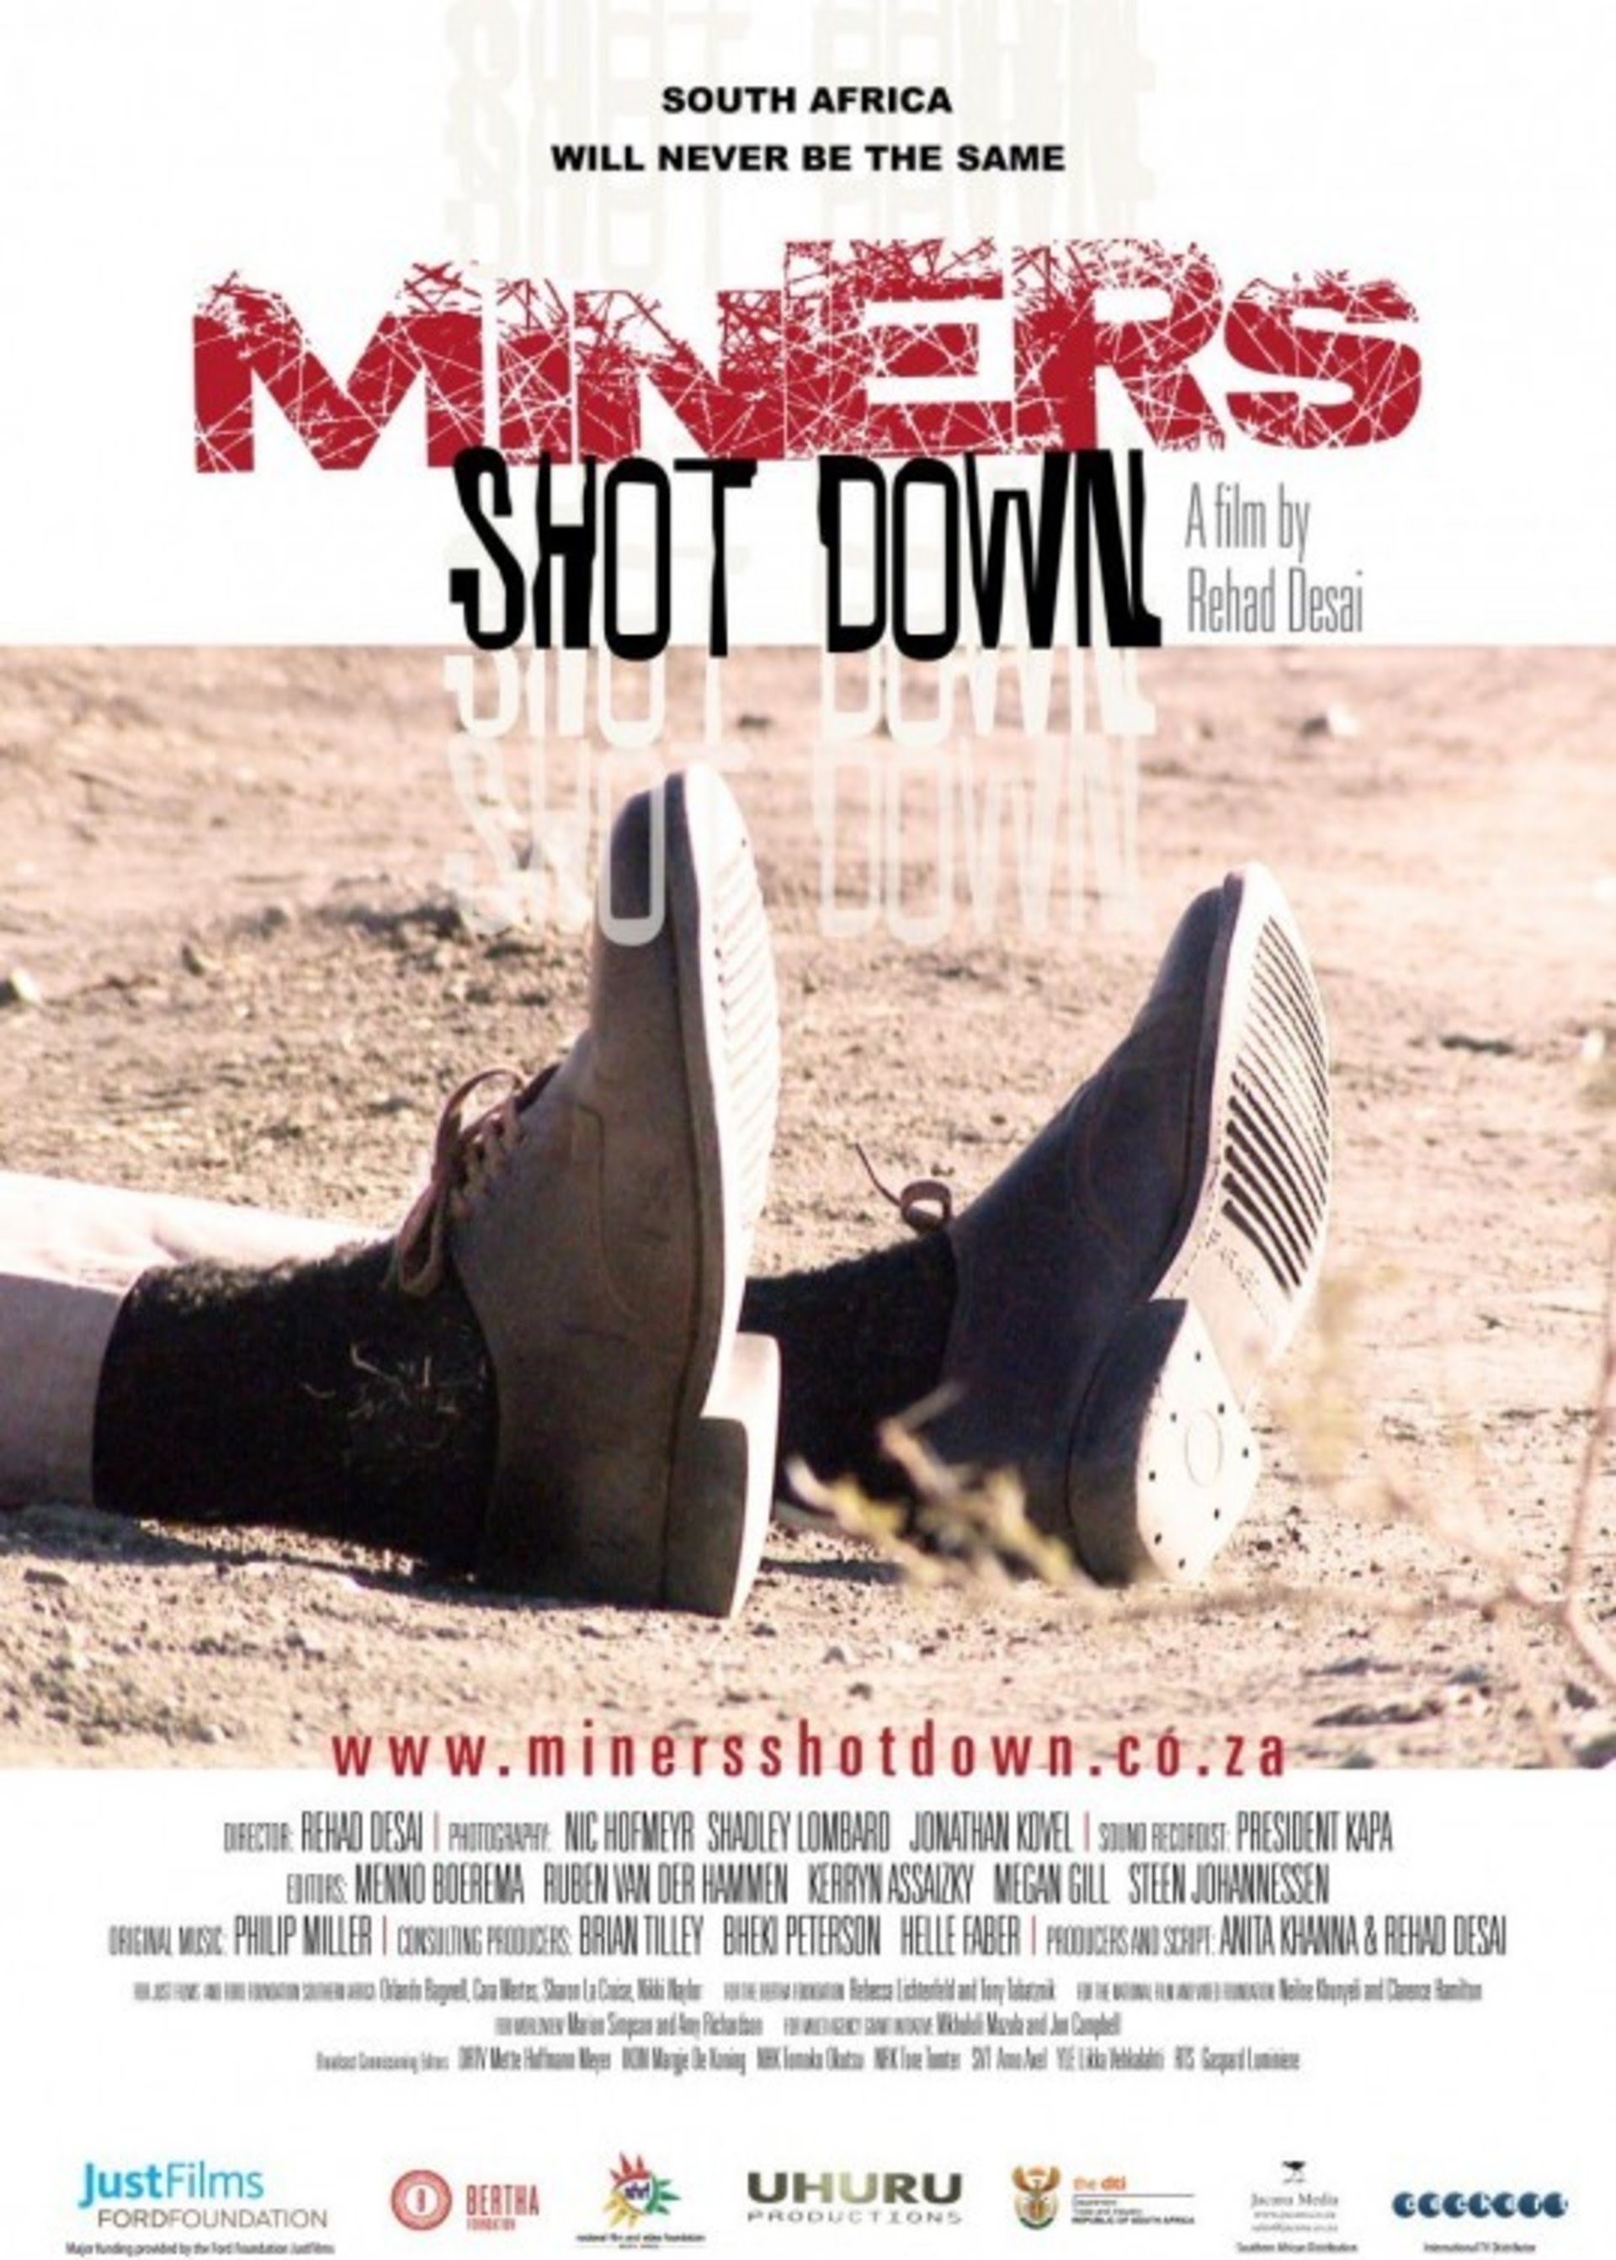
Notes:
The most accessible genre of filmmaking, it is often marginalised by the broadcast industry and by other sectors / genres within the film and video production industry. The DFA aims to unify documentary filmmakers and gain recognition for the genre.

Slide 5
DFA Membership
177 paid up members today
Diverse and national
Notes:
As of yesterday there are 177 paid up members, but at times in the membership cycle this exceeds 250. Over 10 thousand followers and fans. Each member employs many freelancers and has a multiplier of at least 2.5.
We represent a diverse and transforming group of filmmakers operating in all provinces.

Slide 6








Volunteer organiSed industry
✓
✓
✓
✓
6
Notes:
The DFA is a key member of SASFED (The South African Screen Federation) presenting Friday so will focus on specific areas not in their presentation to avoid duplication of broader industry issues. Support their presentation as founding and active member of SAFED, tomorrow Mid Day. All those with ticks are doing specific presentations here.
The DFA is a registered Non Profit Organisation (NPO) that is solely dependent on fundraising. All people include those sitting here are unpaid volunteers, and full time filmmakers.

Slide 7


Support
Balance of copyright
Notes:
DFA supports balanced copyright law. As creators of film and television works, we have an interest in the ownership of copyright in the work we create. On the other side of the balance of copyright, all copyright Acts (including the South African one) also contain provisions, sometimes known as “user rights”, that allow those producing new work to use copyrighted material without permission or payment in some circumstances.

Slide 8
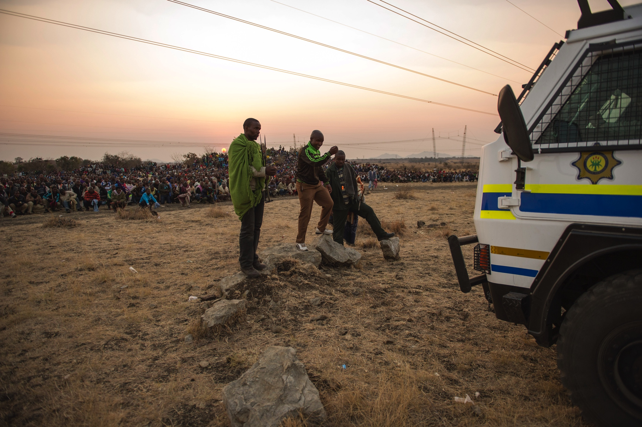
Right to quotation, and use of existing material.
Notes:
For example, documentary filmmakers commonly utilise their rights to use quotations of copyrighted music, photographs, film footage, brands and other material in order to comment on or criticise that work or to illustrate a point or argument. For documentary filmmakers and other media makers, these features of copyright law are often essential to promote free expression and ensure that copyright does not operate as a charter for censorship. Quick example – Miners Shot Down.

Slide 9








Drafting – Lack of balance, Uncertainty & Complexity
Notes:
Overall, there is much in the 2017 bill that is supported by doc filmmakers.
We are not equipped to comment in much detail, but agree poor drafting – identified by many presentations already – leads to uncertainty.
Our sector suffers with complexity, and lack of certainty. There are at least 3 major sectors of government which we cross over regularly with our sector, trade & industry, arts and culture, and communications, and sub-sets like NFVF and ICASA. Much of the amendments to this bill do not helped this complexity and we find little chance with the task of rising the hard to find funds and make documentaries.

Slide 10

Documentary specific concerns
Support SASFED Presentation tomorrow Documentary focus fair dealing / fair use.
Sections 21(1)(C) – Proposed amendment to commissioned ownership.
Section 5 – Ownership of state funded works.
Section 12 – Right of Quotation – Summary addition affect.
Section 12 – General Exceptions.
Section 15(1) - Incidental Capture
Orphaned Works
Notes:
We strongly support the need to update the Copyright Act to fit our current uses and technologies as filmmakers.
In addition to and supporting the SASFED presentation which Marc will do tomorrow, we raise our concerns specifically as Doc Filmmakers and The Bill, falls short on two key points explained in more detail in the comments that follow:
The 2017 bill (Sections 21(1)(C) and 5) fails to adequately protect the interests of filmmakers in owning copyright in the films they create.
Despite some notable improvements, the bill fails to adequately protect the rights of filmmakers to make fair uses of copyrighted works.
permission or payment in some circumstances.
In summary here is what we would like to discuss over the next few mins.
Support SASFED presentation fully tomorrow, and have highlighted a few points they will also make, but recognise documentary has a larger focus on re-use of existing material. Recognise that will also mean we as creators will need to give up our own. Thus support a greater inclusion of Fair dealing provision and ideally fair use.

Slide 11
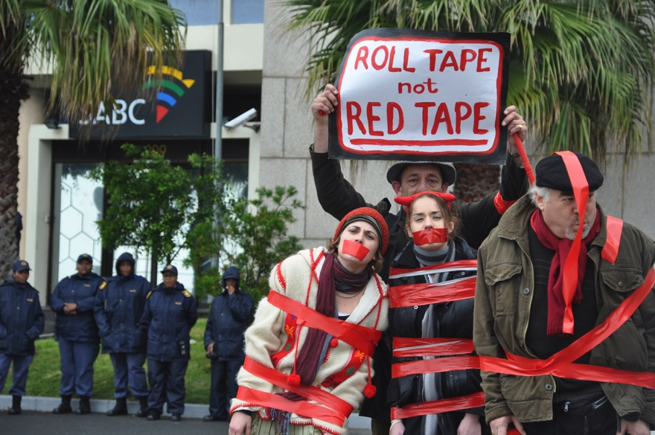
IP Ownership
Notes:
Documentary in SA often commissioned by public broadcaster.
Right ownership has been our sectors battle for more than two decides, and documentary especially affected. Our stories almost never leave SA as a result and we have lost many of our filmmakers as a result.

Slide 12
Sections 21(1)(C)
(c) Where a person commissions the taking of a photograph, the painting or drawing of a portrait, the making of a gravure, the making of a cinematograph film or the making of a sound recording and pays or agrees to pay for it in money or money's worth, and the work is made in pursuance of that commission, such person shall, subject to the provisions of paragraph
(b),be the owner of any copyright
subsisting therein by virtue of
section 3 or 4.
Notes:
Denies SA Filmmakers copyright in their works.
Vests ownership of a commissioned “cinematographic film” (old wording – not suture proof anyway) in the commissioning entity, rather than the author of the film.
Current Old Act states:
Section 21(1)(c) has long operated to deny South African filmmakers copyright in their works.
Section 21(1)(c) of the South African Copyright Act vests ownership of a commissioned “cinematographic film”in the commissioning entity, rather than the author of the film. . This is exception for only a crew classes of creative works, in which IP may vest.. Others are normally specific to people commissioning, you don’t a photograph, portrait or a graver (goodness how dated) of yourself and not want the flights… but with film we are simply commissioned to meet an needs of a public TV slot, and create the work itself with significant investment.

Slide 13
Sections 21(1)(C)
Bill Proposes amendments:
Governed by contract
Failing contract commissioner - Licence
SABC PFMA default of law – Balance of power
Section 21 (1) (e) - contract default
Section 21(1)(c) should be
struck from the bill.
Notes:
The 2017 bill amends Section 21(1)(c) to add language that clarifies that “the ownership of any copyright subsisting in the work shall be governed by contract.” But the bill retains the default position against that of the author, stating:
in the absence of valid contract, ownership shall vest in the person commissioning the work and the author of the work shall have a licence to exercise any right which by virtue of this Act would, apart from the licence, be exercisable exclusively by such author.
In the absence of contractual terms to the contrary, the default provision for other works is that copyright vests with the author who makes the creative decisions in the production of the work. This would be the rule that operated if section 21(1)(c) (and section 5, as discussed below) did not exist.
Many South African filmmakers – and especially documentary filmmakers -- do not own any copyright in the films they produce because section 21(c) gives ownership to the commissioning party as a default, and most films are commissioned by a funder.
The denial of copyright to filmmakers impacts their livelihoods as well as their ability to express themselves as artists. Commissioned films are often shown once on television, never to be seen again, because the filmmaker lacks the rights in the film to license it to others. They thus also lack the rights to continue profiting from their work, reducing the market potential of South African films.
SABC and with it other broadcasters have always argued for default position on rights ownership based on section 21,1 c, without contract to contrary per 21 (1) (e). Other broadcasters follow SABC. Need to address to restore balance of power.
Section 21(1) e always allowed for contract to change default so why repeat its an option now?
Section 21(1)(c) should simply be struck from the bill. Rights for ALL these classes should vest with author / creator and contract must transfer if required.

Slide 14
Section 5: State Ownership of “funded” works
Funding for Docs and other films and TV
SABC
NFVF
DTI
Film Commissions
Required to attract foreign
investment
Notes:
Funding reality in SA dictates Docs are made wither with the public broadcaster, or government funding such as SABC, DTI , NFVF etc.

Slide 15
Section 5: State Ownership of “funded” works
(2)(a) Copyright shall be conferred by this section on every work which is eligible for copyright and which is made by, funded by or under the direction or control of the state or [such] an international [organizations as may be prescribed] or local organisations.
(b) Copyright conferred in terms of paragraph (a) shall be owned by the state or organisation in question.
Notes:
It is proposed in the 2017 bill that the government would own the copyright in any work that is “funded by” the state:
5
(2)(a) Copyright shall be conferred by this section on every work which is eligible for copyright and which is made by, funded by or under the direction or control of the state or [such] an international [organizations as may be prescribed] or local organisations.
(b) Copyright conferred in terms of paragraph (a) shall be owned by the state or organisation in question.’’

Slide 16






Section 5: State Ownership of “funded” works
Rights ownership for SA Industry
Sustainable Independent
Industry
Other investment
Notes:
Nearly every movie made in South Africa is funded, at least in part, by a state entity -- either through the SABC, through the National Film and Video Foundation’s production development grants of the Department of Arts and Culture, or through the DTI’s Film and Television Production Incentives. Enacting the proposed change to Section 5 would thus deprive most filmmakers of the right to own their copyright. Should any state entity require license or ownership of copyright in any specific production contracted and intended for state use, a contract can be required which transfers such rights as part of the tender process. Such transfer could be structured to not affect the spirit of co-operation and rights generation for the works creator, who often receive funding from other sources.

Slide 17
Section 5: State Ownership of “funded” works
(2)(a) Copyright shall be conferred by this section on every work which is eligible for copyright and which is made by, funded by or AND under the MAJORITY direction or control of the state or [such] an international [organizations as may be prescribed] or local organisations.
(b) Copyright conferred in terms of paragraph (a) shall be owned by the state or organisation in question.
Notes:
We thus propose that Section 5(2) be deleted from the current act, allowing the same copyright defaults to operate for all works.
Alternatively we suggest the or be changed to an AND as indicated on the screen.
May still be an issue with SABC commissions who claim to control and give creative input by virtue of commissions and cost control mechanisms.

Slide 18
Fair Use / dealing
Since 2008
Review of current laws
Documentary focus research
7 Workshops
Dr. Sean Flynn & Tobias Schonwetter
Notes:
Recognize the need to create new works from existing material, and that material often held up by monopolies and international mega corps.
Since 2008, the DFA has been host to at least 7 workshops on the issue with a Doc Focus, starting by analyzing existing copyright act and looking at what could help in future. That’s where section 21’s came from.

Slide 19
Fair Use / dealing
Research on Documentary Industry
80% avoided using - in order to avoid the licensing process.
69% forced to limit distribution of films because of the limited scope of licenses for material used in the film.
74 sign licenses that only permit limited circulation of material.
Notes:
Research we did a few years back with Sean Flynn on the local doc industry reflects.
Eighty six percent of the interviewees stated that they had avoided using desired material in a film or substituted inferior content in order to avoid the licensing process.
Sixty-nine percent of the filmmakers interviewed stated they had been forced to limit distribution of their films because of the limited scope of licenses for material used in the film.74 Filmmakers explained that they sign licenses that only permit circulation of the material for a limited time or to particular (e.g. local) markets.
UNTOLD STORIES IN SOUTH AFRICA: CREATIVE CONSEQUENCES OF THE RIGHTS CLEARANCE CULTURE FOR DOCUMENTARY FILMMAKERS
Sean M. Flynn Peter A. Jaszi
https://papers.ssrn.com/sol3/papers.cfm?abstract_id=1654025

Slide 20
Fair Use / dealing
“User” Rights confusion
Digital Age
Users are themselves creators
Industry de-professionalisation
Notes:
Fair Use / Fair dealing: User” Rights confusion Digital Age realities are upon us. / Users are themselves creators / Industry de-professionalisation is partially inevitable.. unless rights are valued.

Slide 21
Fair Use / dealing
Retaining the existing quotation right
Expanding incidental use to include audio visual works
Enacting fair use
Done responsibly
Notes:
Believe these core values are critical to ensure the legal enabling environment for fair quotation in films: Retaining the existing quotation right / Expanding incidental use to include audio visual works / Enacting fair use / Done responsibly.

Slide 22
Sections 12 & 15
Section 12 – Right of Quotation – Summary addition affect.
Section 12 – General Exceptions.
Section 15(1) - Incidental Capture
Orphaned Works
See written submission.
Notes:
Section 12 – Right of Quotation – Summary addition affect./ Section 12 – General Exceptions. / Section 15(1) - Incidental Capture / Orphaned Works - For all these pelase see our written submission.

Slide 23
Balance of copyright for creators and to allow for new works.
Web: www.docfimsa.com
E-Mail: marc@docfilmsa.com

