Slide 1

Empirical Research Impact of Copyright User Rights in Digital Environment
Sean Flynn, American University Washington College of Law
(CC) (BY)
Notes:
Start at the Stockholm conference and how international law and trade law is part of the globalization of fair use.
What is fair use?
Is it globalizing.
I will stop there – but will tantalize you with the heading of the next part of the project – whether globalizing fair use is good for you. Invite me to your school and I will tell you that story.

Slide 2
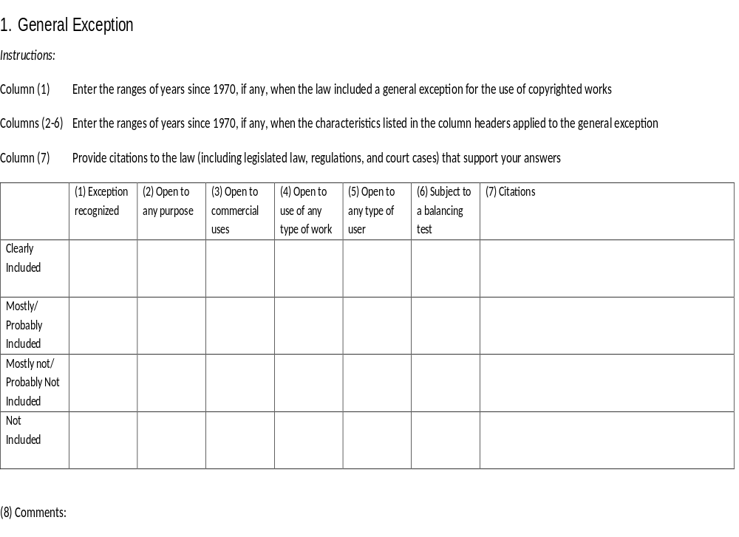
Notes:
We set out to build a database. The data base focuses not on whether a country has fair use per se, but whether and where they have the operational elements of fair use we think are important – openness, flexibility, generality.

Slide 3
Survey Consisted of Questions on 20 Different User Rights Found in Copyright Law
General Exception
Quotation
Education
Research
Personal or Private Uses
Computer Programs
Databases or Other Compilations of Non-Original Facts
Text- and Datamining
Library Rights
Disability Access
Transformative Use
Parody and/or Satire
Incidental Inclusion
Panorama right
Orphan Works
National Government Works
Exhaustion of Rights
Safeguards From Secondary/ISP Liability
Temporary Copies for Technological Processes
Supremacy of Contracts
Notes:
Like others, we ask about a series of specific exemptions. But we drill much deeper into the specific construction of them. In each case – do they have elements of openness, flexibility, generality?

Slide 4
21 Country Responses So Far
Australia
Chile
Finland
Japan
Korea
Netherlands
Portugal
Singapore
Slovakia
Switzerland
United States
Argentina
Botswana
Brazil
China
Colombia
India
Peru
South Africa
Ukraine
Vietnam

Slide 5
Responses Received
Responses Not Yet Received
Argentina | Peru
Australia | Portugal
Botswana | Singapore
Brazil | Slovakia
Chile | South Africa
China | South Korea
Colombia | Switzerland
Finland | Ukraine
France | United Arab Emirates
India | United States
Japan | Vietnam
Netherlands
Austria | Mexico
Canada | New Zealand
Czech Republic | Poland
Denmark | Romania
Guatemala | Rwanda
Hong Kong | Slovenia
Hungary | Taiwan
Ireland | Uganda
Israel | United Kingdom
Notes:
There are some countries for which people signed up, but haven’t yet sent us the completed surveys.
If your country is on the right or not here, and if you have deep knowledge of copyright over time in your country... Come see us!

Slide 6
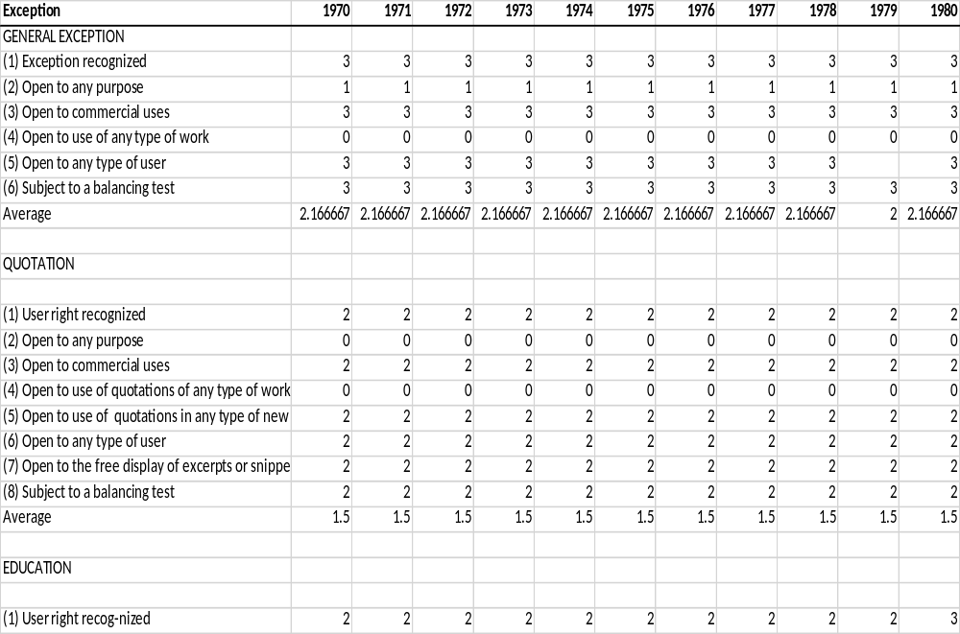
Example of a Coded Survey
Notes:
SF showed the survey structure, where we ask a series of questions for multiple types of exceptions
Also things that are not “exceptions” but still affect UR, i.e. copyright exhaustion and contractual override
we ask the status of each of these questions on a four point scale for each year from 1970 to present, which we code.
This is how we code it at first, in a way that is easier for humans to read

Slide 8
Openness Score: High v. Middle Income Nations

Slide 9
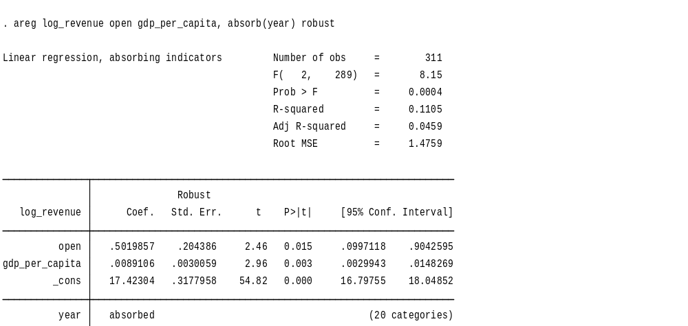
Positive Regression: Open User Rights -- Information Firm Revenue
Notes:
Yes – positive correlation between openness and information firm revenue.
Revenue – log. Control for skewed dat.
Cons – constant. Y=mx + b. Constant is B.
Revenue = constant +x(open)
T – statistical significance. Want greater than 2 (at 5% level).
P>(t). Want P less than 0. Probability of finding higher T by chance. Want close to 0.
Wide confidence interval.
R squared – low. Only describing small amount of variation around mean. Wand higher than .03.
Controlling for size of market (gdp) and time.
Now – controlling firm size. Total assets. (employment – missing data).
We using Thompson bus classification scheme. Could also use NAICS.
331 observations. Relatively small.

Slide 10
Open User Rights & Citations “H-Index”
Notes:
- This is the average H-index for the period 1996 to 2015
- Clear positive association between the h index and our openness score

Slide 11
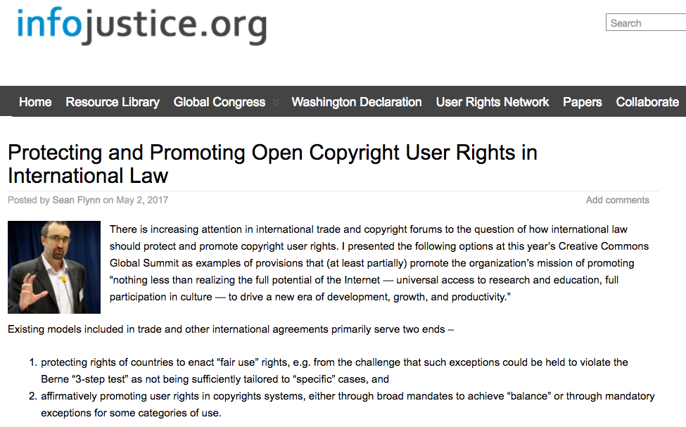

Slide 12
Sflynn@wcl.american.edu
Director, AUWCL LLM in IP

Slide 13
