Slide 1
Copyright Untangled
Re:publica 2017
“Fixing Copyright for Education- An Australian perspective”
Delia Browne
National Copyright Director
National Copyright Unit
www.smartcopying.edu.au
https://www.slideshare.net/nationalcopyrightunit

Slide 2
National Copyright Unit (NCU)
The Ministers’ Copyright Advisory Group (CAG), through the NCU, is responsible for copyright policy and administration for the Australian school and TAFE sector. This involves:
  Managing the obligations under the educational copyright licenses with collecting societies;
  Advocating for better copyright laws on the School and TAFE sector’s behalf;
  Educating the School and TAFE sector regarding their copyright responsibilities.
  Develop and Implement Smartcopying practices:
    Education Lead for Creative Commons Australia;
    Advocate for the use and creation of OER in Australia.
  Copyright advice to schools and TAFEs
Notes:
NCU is a small specialist unit represents:
Schools in Australia on copyright matters to the Council of Australia Government (COAG) Education Council. Reports to Federal, State and Territory Departments of Education, all Catholic Education Offices and the Independent Schools Council of Australia. NCU represents the almost 9,500 primary and secondary schools in Australia and their 3.5 million students and majority of State and Territory TAFE institutes.
The NCU main tasks are:
Negotiate and manage the collective statutory and voluntary licences with collecting societies on behalf of Schools and TAFE (current license fees are approximately $90 million per annum);
Respond to copyright and other relevant law reform inquiries on behalf of School and TAFE sectors;
Provide specialist copyright advice to Schools and TAFEs and their respective jurisdictions on copyright issues affecting schools and TAFE
Implement Smartcopying practices to reduce copyright licensing fees, which includes, among other things:
progressing OER in Australia
maintaining the Smartcopying website www.smartcopying.edu.au and the National Copyright Unit Slideshare.
Copyright 4 Educators www.p2pu.org
Smartcopying website www.smartcopying.edu.au

Slide 3
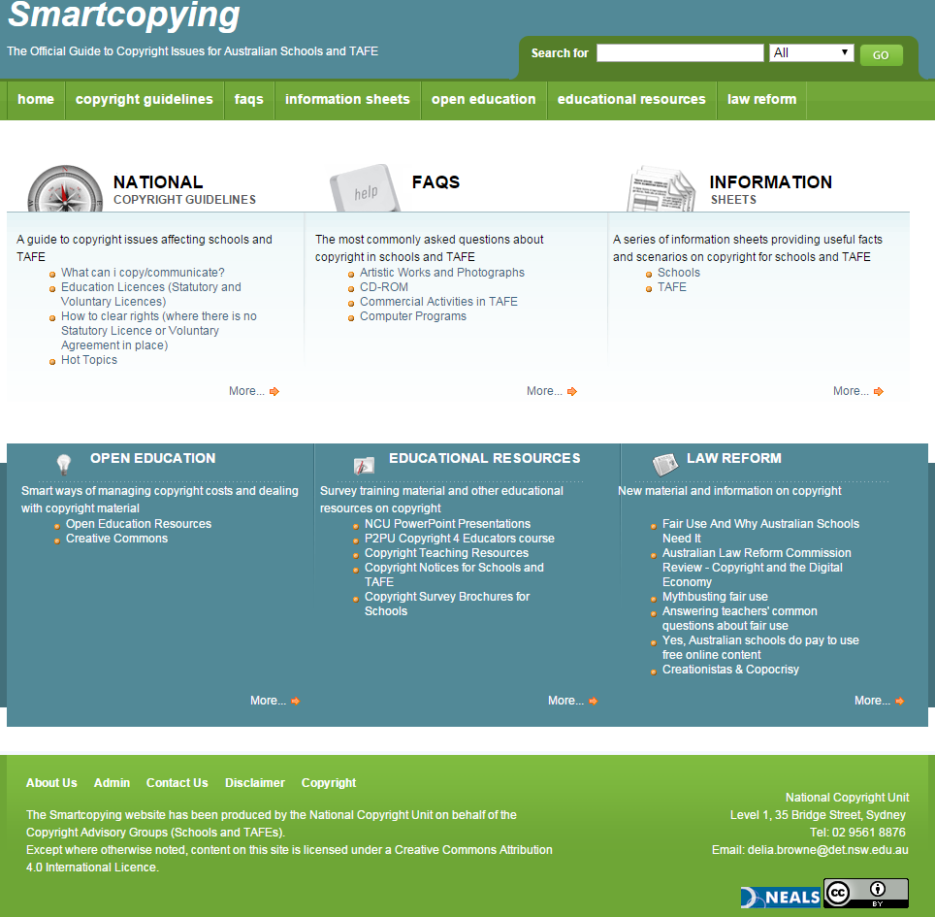

Slide 4


Slides available @ http://www.slideshare.net/nationalcopyrightunit/
This work is licensed under a Creative Commons Attribution 4.0 International License
(unless otherwise noted)
http://creativecommons.org/licenses/by/4.0/

Slide 5
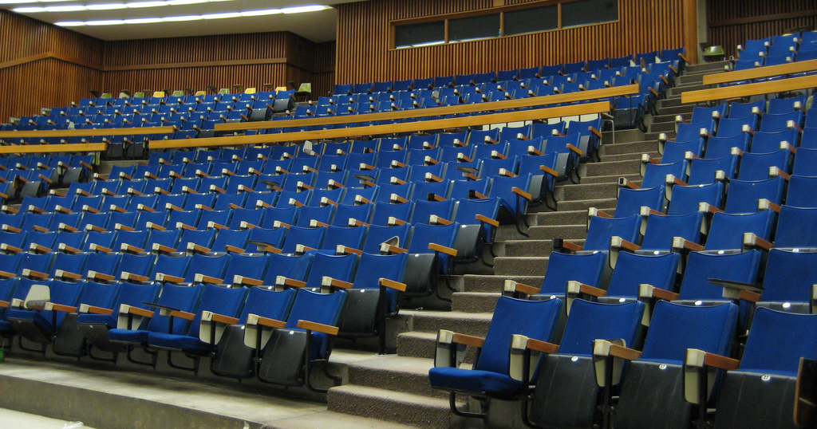
Education no longer means this…

Slide 6
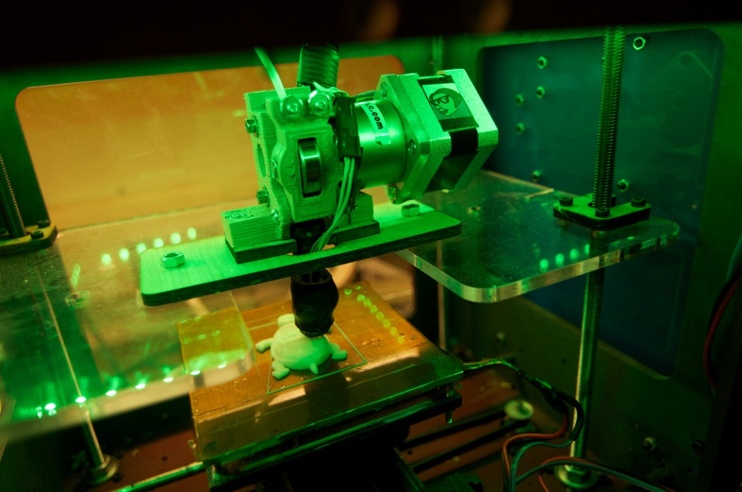
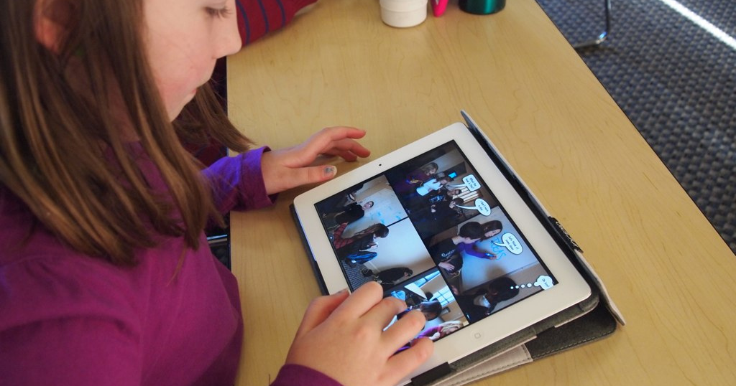
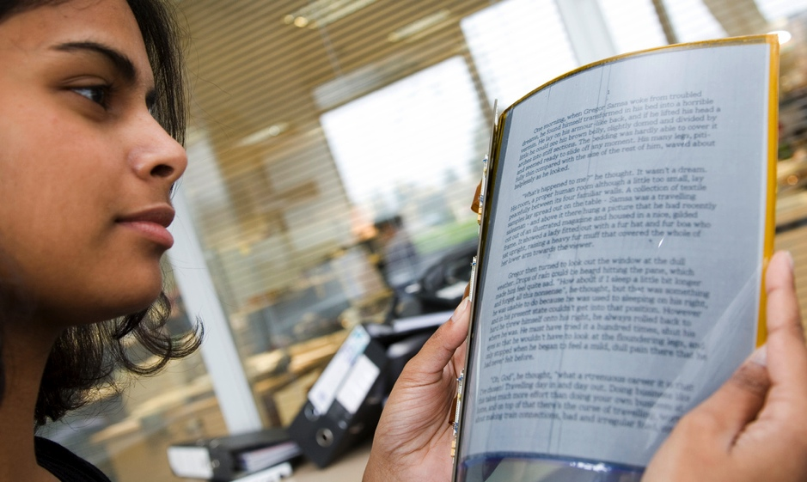
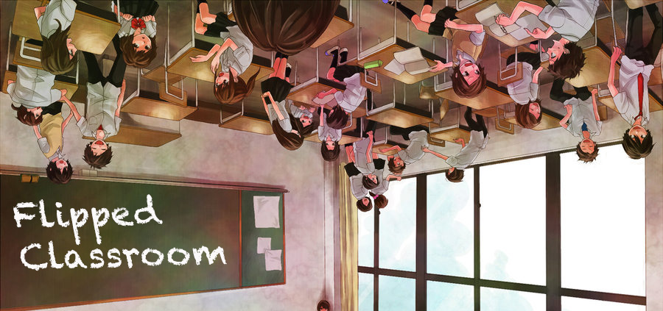

Now means this…

Slide 7


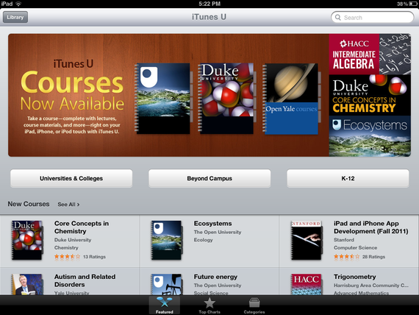
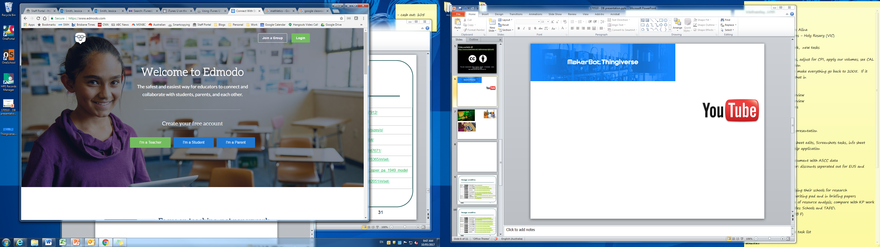



Slide 8

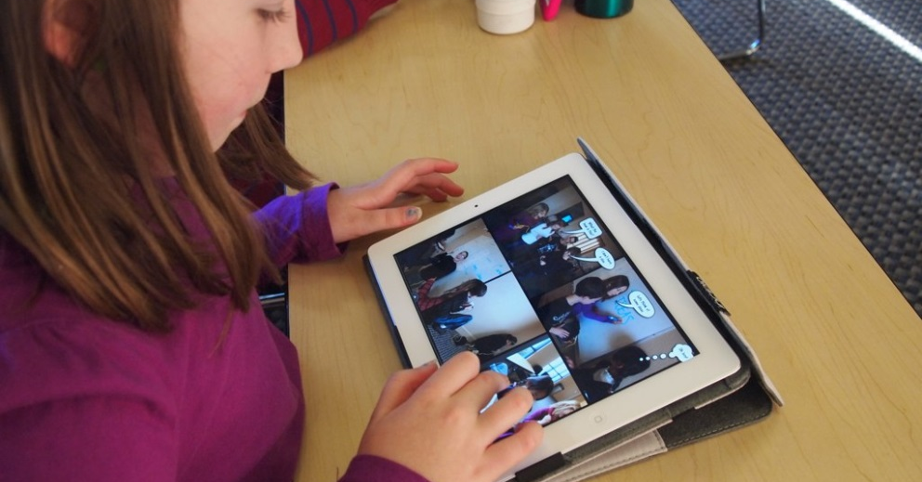


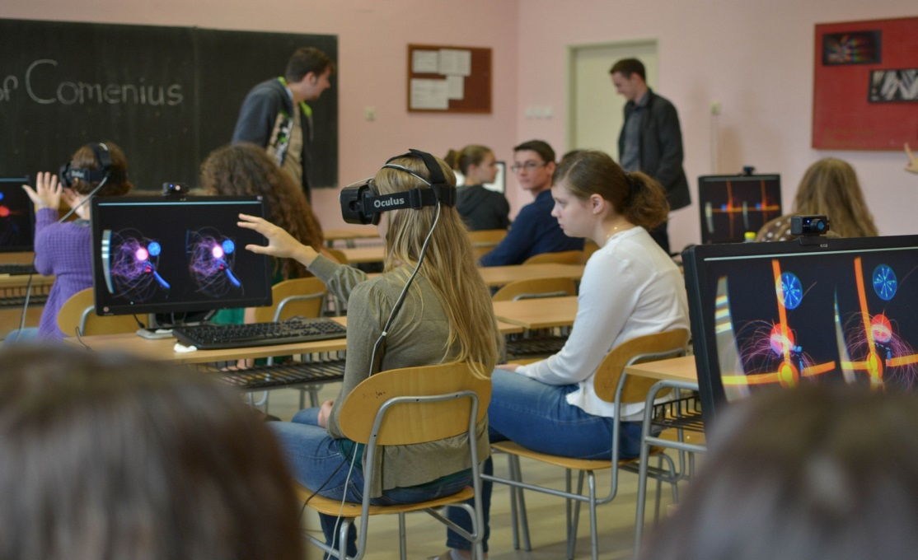

Slide 9
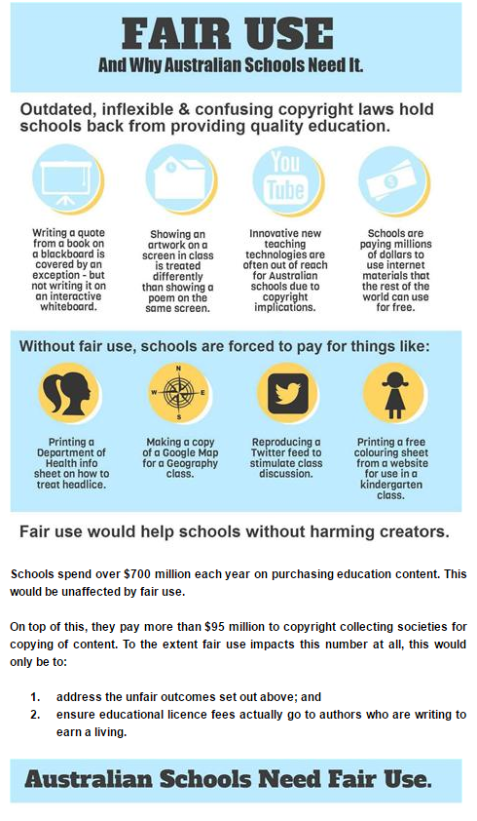

Slide 10
Copyright laws outdated and inconsistent
Copyright laws designed in the age of the photocopier are not working in the age of the iPad the 3D printer, data and text mining and are holding back innovation in schools
Inconsistent rules for educational use around the world, most countries have minimum copyright protection and enforcement provisions in their domestic copyright law – required by multi lateral treates ( such TRIP/GATT, WCT) but there are no minimum standard for educational use or other non harmful public interest uses

Slide 11
The Race to STEM
75 of fastest growing occupation require STEM skillset
Worldwide drive to provide specialist STEM education alongside the standard school curriculum
OECD reports STEM deficits in Australia as well as EU- one of the greatest concerns for business community and government
Schools increasingly focusing on real life scenarios that combine skill based challenges, innovative hands on practical work,and motivational game like activities
Notes:
STEM- Australian Commonwealth Policies
Science, Technology, Engineering and Mathematics
The Federal Government has educational and innovation policy objectives of delivering world class STEM education.
In 2014, Australian Government’s Industry Innovation and Competitiveness Agenda— $12m package
Australian Maths and Science Partnership Program — $16.4m

Slide 12
New learning and new technologies, outside experts
Students improve their critical and creative thinking, problem solving and communication skills
Students use new equipment , explore new concepts and learn new techniques
New assessment and data analytics help teachers to quickly evaluate the impact of teaching and learning strategies and constantly creating new resources for student engagement and learning
Many schools invite specialists and business to work with students

Slide 13
Australian Classrooms in Space
http://www.dailytelegraph.com.au/news/nsw/students-at-a-western-sydney-school-are-busy-devising-products-to-be-used-by-nasa/news-story/9065719e19db0b3f8b0b7e3f34a932ec
http://newsroom.unsw.edu.au/news/students/unsw-student-send-first-australian-owned-payload-international-space-station
Notes:
Merivale High schools has developed a moisturiser to use in the space which will be tested by the astronauts in space
1000 students across 40 schools – dozens of their experiments blasting into space
experiments that will be able to measure the radiation astronauts are exposed to on the ISS, gauge the change in speed or altitude during an evasive manoeuvre, or use patterns in the data to create visual or audio artworks.

Slide 14
Complex Inflexible and out dated copyright law
Current copyright laws penalise teachers for using new technologies in Australian classrooms.
Complex web/mix of compulsory /statutory licences for educational use by educational institutions where non prejudical/non consumptive and technical uses are remunerated alongside some free educational use exceptions
No anti circumvention exceptions for legitimate non prejudicial educational uses

Slide 15
Inflexible and out dated copyright law
  different copyright rules apply depending on whether teachers use blackboards or interactive whiteboards
  Australian schools pay millions of dollars each year simply to use freely available Internet materials such as health fact sheets or overseas free teaching resources
  Educational uses that are freely permitted in other countries, Australian schools schools pay licence fees:
    taking a screenshot to use in a project,
    a teacher asking a student to print a map from Google maps for a homework exercise;
    displaying a Spanish translation using a translation app to a Spanish class;
    taking screenshots of course offerings at a number of universities’ websites;
    taking a screenshot of a website that compares times in different cities around the world.

Slide 16
Real life examples of not so free internet material
Displaying an image of a cat on screen from www.petfinder.com.au;
Taking a screenshot of a website that compares times in different cities around the world;
Printing out a factsheet on head lice from the Department of Health and Ageing’s website to hand out to students;
Taking a screenshot of a yellow raincoat from an online Bunnings Warehouse advertisement to include as a graphic in a PowerPoint presentation.

Slide 17
Copyright exceptions not fit for digital age
Worse, Australia’s outdated copyright exceptions often don’t apply to digital technologies.
Many traditional educational uses (such as playing a movie to show to students in a classroom) are no longer permitted - or attract additional licence fees - if teachers choose to use digital technologies or provide online alternatives to traditional classroom activities, instead of older ‘chalk and talk’ approaches.
Not clear what educational use of educational apps and games is allowed
Schools pay for use of “orphaned works”

Slide 18
Copyright reform key to
Innovation and Education

Slide 19
Fixing Copyright
2013 The Australian Law Reform Commission Review (ALRC )
2017 Productivity Commission’s report into intellectual property arrangements
2016 Ernst & Young cost benefit analysis of the ALRC’s proposed Copyright Reform (ie fair use)
Copyright Amendment (Disability Access and Other Measures) Bill 2017

Slide 20
ALRC: 2013-2014
Australian Law Reform Commission report into Copyright and the Digital Economy
  The Australian Law Reform Commission (ALRC) was asked to consider whether the current exceptions and statutory licences in the Copyright Act are adequate and appropriate in the digital era.
  an 18-month inquiry during which the ALRC produced two consultation documents, undertook 109 consultations and received 870 submissions.
  Tabled in Feb 2014, The report contains 30 recommendations for reform. The key recommendation is for the introduction of a fair use exception to Australian copyright law.
  The report provided strong support for the copyright reforms sought by the education sector.
This was a significant and extremely extensive review of copyright law --- the biggest in 25 years.

Slide 21
ALRC:
Exceptions in the Copyright Act have not kept pace with changes in technology and practice, and are no longer fit for purpose.
Central recommendations
  Simplification and streamlining of statutory licences( removing outdated administrative burdens)
  Introduction of a flexible ‘fair use’ exception to copyright
Notes:
ALRC - background
In February 2014 the Government released the Australian Law Reform Commission’s (ALRC) report Copyright and the Digital Economy. The ALRC received 870 public and 139 confidential submissions and undertook 109 consultations with a full range of stakeholders. It’s conclusion at the end of this process was that the exceptions in the copyright act had not kept pace with changes in technology and practice, and are no longer fit for purpose.
ALRC – Statutory licences
In its final report on Copyright and the Digital Economy, the Australian Law Reform Commission (ALRC) has made some recommendations to retain, but simplify and make less prescriptive, the statutory licensing scheme.
Whilst the ALRC has moved back from its earlier recommendation on repealing the statutory licensing scheme, it flags that if the fair use and new exceptions for government use are not introduced, there would be reason to revisit repealing the statutory licensing scheme.
The ARLC also recommends a number of reforms to address specific criticisms of the statutory licensing scheme, including:
clarification that the statutory licences do not apply where use of material falls within an exception to copyright - this will be particularly important if the ALRC’s recommendations to introduce a fair use exception or expand the existing fair dealing exceptions are accepted
clarification that statutory licences do not apply where an alternative licence is negotiated – a clarification that is recommended as a check on the market power of collecting societies
removal of requirement that governments must notify or pay equitable remuneration to a declared collecting society, so that governments have the option to deal directly with rights holders
making statutory licences less prescriptive and more flexible - detailed provisions concerning the setting of equitable remuneration, remuneration notices, records notices, record keeping, sampling notices and survey requirements should be removed and terms should be agreed between the relevant parties, or by the Copyright Tribunal
ALRC – Fair use
The central recommendation was the introduction of a flexible ‘fair use’ exception to copyright. This recommendation is supported by schools, universities, cultural institutions, consumer organisation, libraries, tech companies and organisations assisting the blind and visually impaired.
Currently any use that does not fall within one of the specific copyright exceptions infringes copyright, leading to problems such as:
cultural institution being unable to digitise cultural heritage;
tech companies unable index and cache onshore; and
consumers with different rules for their home use of VHS tapes compared to DVDs.
Fair use by comparison is a broad, flexible exception for copyright use that is based on the central question, ‘is this use fair’? To determine whether a use is fair, four factors are weighed:
the purposes and character of the use;
nature of the material;
the amount used; and
the effect on the market for/value of the material.
The ALRC also proposed that 11 illustrative purposes should guide the courts as to uses that were more likely to be fair, such as education, reporting the news and disability access.
The introduction of fair use would replace almost 30 existing technical exceptions, increasing the clarity and cohesion of Australia’s copyright law. It will be easier to comprehend, especially for lay people trying to work out the limits of exceptions available to them.
The ALRC recommended fair use because it will assist in innovation, match consumer expectations, be more flexible and protect the market for artists and creators. The world’s largest exporter of cultural goods, the USA, has a fair use system, as do Singapore, Israel and South Korea.
As the ALRC states, the effect of the reforms, including the introduction of fair use, will be that:
“Australian copyright law can be applied to new technologies and new commercial and consumer practices, without constant recourse to legislative change. Fair use will promote innovation and enable a market-based response to the demands of the digital age. The reforms will enhance access to cultural material, without undermining incentives to create. The recommended exceptions are also intended to be more consistent with public standards of fairness.”
We are hopeful that the change of government and the PC Review will lead to a renewed interest in the fair use debate in Australia. (read that as we’re pretty sure it’s got a pretty good chance now, as long as the PC review gives Turnbull an economic excuse).

Slide 22
ALRC : FAIR USE
ALRC recommended Australia adopt a fair use exception, enabling educational uses in schools - irrespective of the technological form of delivery - when these uses are fair to copyright owners.
This would put Australian schools on an equal footing with schools in the US, Israel , Korea, Singapore and Canada
Freeing teachers to make full use of the most up to date digital technologies in the classroom.

Slide 23
ALRC FAIR USE
The ‘fairness factors’ recommended by the ALRC would ensure that if a particular use harms a copyright owner’s market, the use is highly unlikely to be fair.

Slide 24
Fairness factors
The non-exhaustive list of fairness factors should be:
(a) the purpose and character of the use;
(b) the nature of the copyright material used;
(c) in a case where part only of the copyright material is used—the amount and substantiality of the part used, considered in relation to the whole of the copyright material; and
(d) the effect of the use upon the potential market for, or value of, the copyright material.

Slide 25
Illustrative purposes
Proposal 4–4 The non-exhaustive list of illustrative purposes should include the following:
(a) research or study;
(b) criticism or review;
(c) parody or satire;
(d) reporting news;
(e) non-consumptive;
(f) private and domestic;
(g) quotation;
(h) education; and
(i) public administration.

Slide 26
Why education supports fair use
Fair use replaces almost 30 existing complex and out dated technical exceptions
Easier for teachers and the ordinary citizen to understand comprehend, especially for lay people trying to work out the limits of exceptions available to them.
Will promote innovation, match consumer expectations, be more flexible and protect the market for artists and creators. The world’s largest exporter of cultural goods, the USA, has a fair use system, as do Singapore, Israel and South Korea.
  “Australian copyright law can be applied to new technologies and new commercial and consumer practices, without constant recourse to legislative change. Fair use will promote innovation and enable a market-based response to the demands of the digital age. The reforms will enhance access to cultural material, without undermining incentives to create. The recommended exceptions are also intended to be more consistent with public standards of fairness.”

Slide 27
Fair use PLUS Collective licensing
Statutory Licensing for educational use will co exist and cover educational uses not covered under the proposed new exception- such as permanent digitial storage of third party content in the cloud or learning management system
Schools would no longer be disincentivised to use digital technologies due to outdated copyright exceptions, or to pay for uses where no copyright owner ever expected to be paid, such using freely available internet material free online tourism maps of health department head lice fact sheets.

Slide 28
Productivity Commission (PC)
PC asked to consider whether current intellectual property arrangements provide an appropriate balance between access to ideas and products, and encouraging innovation, investment and the production of creative works.
  What the role that fair dealing and/or fair use can play in striking a better copyright balance;
  whether copyright remains “fit for purpose”;
  whether changes are needed to reduce the compliance and administrative costs associated with intellectual property rules.
Notes:
The Productivity Commission has been asked by the Commonwealth Government to conduct a public inquiry into Australia’s intellectual property system, including copyright.
In early October, the Productivity Commission released an Issues Paper (http://www.pc.gov.au/inquiries/current/intellectual-property), and is seeking input on questions that include the role that fair dealing and/or fair use can play in striking a better copyright balance, whether copyright remains “fit for purpose”, and whether changes are needed to reduce the compliance and administrative costs associated with intellectual property rules.
This review is very important and key to achieving the copyright law reform being sought by the education sector. NCU’s recommendations in the submission will be similar to the recommendations put forth for the ALRC review. AEEYSOC approved all of NCU’s submissions to the ALRC throughout 2012 and 2013.
The Productivity Commission has been directed to have regard to the ALRC’s recommendations in its Copyright and the Digital Economy report. As previously reported to AEEYSOC, these recommendations include not only the enactment of a fair use exception, but also orphan works reform in the form of an amendment to the Copyright Act to limit the remedies available for infringement where a user has conducted a diligent search for the copyright holder.
The framework that the Productivity Commission is adopting will provide another forum for NCU/CAG to advocate for these important copyright reforms.
Submissions in response to the Issues Paper are due by 30 November 2015. The Commission is required to provide a draft report by March 2016 and a final report by August 2016.
NCU is currently drafting a submission to the Issues Paper. A summary of the approach is as follows:
An introduction, highlighting the importance of STEM subjects and setting out the educational copying framework;
An explanation that the existing copyright exceptions are not fit for purpose in a digital environment;
Debunking common myths and misperceptions about fair use;
A demonstration and explanation that the educational copying regime is economically inefficient;
An explanation of the ‘Haines’ issue (ie that schools in Australian are not able to copy on behalf of their students under the existing copyright exceptions);
Give evidence of the economic inefficiencies currently occurring in the copyright regime and how these may be fixed, as well as demonstrating the school sector’s economic contribution and highlighting the benefits of fair use/a flexible exception.

Slide 29
FAIR USE DOES NOT MEAN EQUAL
Australian schools spend more than $700 million a year purchasing educational content for students. That is on top of the
  $ 95 million paid by Schools to collecting societies under statutory licences,
  the amount spent by parents buying textbooks.
A fair use exception would have no impact on this spending. Schools and parents will continue to buy educational resources
Fair use helps address the digital double dipping and means schools will no longer pay for uses of freely available internet material where no one expected to be paid

Slide 30
Productivity Commission report
“Australia’s copyright arrangements lack balance and have been slow to adapt to technological change, imposing costs on the broader community.”
The PC recommended immediate reform :
  the introduction of a fair use exception;
  the need for expanded copyright safe harbours to include educational institutions;
  the need for improved governance arrangements for copyright collecting societies;
  provisions ensuring contractual and technological means cannot be used to override educational copyright exceptions; and
  the need for TPM exceptions to enable educational uses, including assisting students with disabilities.
Notes:
Report released finally in December 2016

Slide 31
PC Report: fair use
Fair use will “better adapt to technological change and new uses of copyright material
PC rejected “implausible” rights holder arguments that fair use would result in schools not relying on the statutory licences. It said adoption of a fair use exception would mean that education may no longer have to pay for uses that do not prejudice the rightsholders interests such as using freely available internet material or ‘ orphaned works.

Slide 32
PC Report: fair use
Fair use would remove the current roadblocks to innovation in Australian classrooms that prevent collaboration with industry and use of the latest teaching methods.
Fair use would also prevent the current unjustifiable waste of education budgets to pay copyright licence fees to use freely available internet materials, or orphan works where the copyright owner can’t be found for payment.
Some recent examples of activities considered remunerable in Australian schools due to the absence of a fair use example include:
  Displaying a Spanish translation using a translation app to a Spanish class;
  Taking screenshots of course offerings at a number of universities’ websites;
  Taking a screenshot of a website that compares times in different cities around the world;
  Telling students to print an information sheet on malaria from The Royal Commonwealth Society’s website;
  Telling students to print a web page from the RSPCA’s website giving information about how to be an animal foster carer.

Slide 33
PC Report: fair use
Introducing a fair use exception to cover uses such as those on the previous slide would in no way harm Australian authors and creators.
The PC notes that rights holder interests are specifically protected under fair use: “fair use does not (as some suggest) mean free use and nor has it in any of the jurisdictions in which it operates as the exception specifically considers the impact of the use on the rights holder
United States, Israel, South Korea and Singapore all hav fair use style copyright exceptions with great success..

Slide 34
PC Report: contractual and technological means cannot be used to override copyright exceptions
Inability to use copyright exceptions due to contractual override has “the potential to restrict uses that have been expressly permitted by Parliament, reduce competition and efficiency, and increase the return to creators over and above what is necessary to incentivise their creation.”
In the pre-digital environment, rights holders had no technical ability to override the copyright balance that Parliament struck between the interests of rights holders and users.
Today contracts and technological protection measures (TPMs) are used by rightsholders to prevent users using permitted and legitimate uses under copyright exceptions- public interest exceptions are under threat.
PC recommended that contractual arrangements not override copyright exceptions and stressed that it is important exceptions are able to operate effectively in the digital environment.

Slide 35
  PC Report: the need for TPM exceptions to enable educational uses, including assisting students with disabilities
Ensuring that TPMs or contractual arrangements cannot override copyright exceptions will ensure that exceptions can operate effectively in the digital environment. For example, even though copyright exceptions allow teachers to make captioned copies of audio-visual materials for students with hearing disabilities, the lack of a corresponding TPM exception means that the exception cannot be used in practice. Australian schools should not be in the difficult position of choosing between assisting students with disabilities and breaking copyright laws.

Slide 36
Ernst & Young report
Ernst & Young was engaged by Government to analysis of the impact of implement a number of the recommendations of the ALRC Report into Copyright and the Digital Economy, namely fair use.
EY report released December 2016
EY found “fair use or fair dealing for education would have a net positive impact on the economy and society”

Slide 37
Ernst & Young report
The main benefits of an exception that permitted schools to make ‘fair’ uses of content without payment would be:
  more effective use of public funds (as schools would no longer be required to pay to use freely available internet content or orphan works, and could undertake other uses of content in ways that did not harm rights holders), and
  greater efficiency in the delivery of education as barriers to schools making greater use of digital technologies were removed.

Slide 38
Ernst & Young report
Said the payment for use of orphan works under the education statutory licences for education and government use should stop.
Estimated a potential reduction of up to $18.3 million a year in the amount that schools pay for the Part VB statutory licence.
little evidence that fair use would substantially increase uncertainty after the initial implementation period, emphasising that “fair use is adaptive (as distinct from uncertain)”.
rejected - the claims made by Copyright Agency and other rights holder groups that fair use would cause harm to educational publishers and reduce the incentives for the creation of educational content.

Slide 39
Copyright Amendment Bill: Simplified Statutory Licence
New simplified and streamlined statutory licence based on the model that was recommended by ALRC in its Copyright and the Digital Economy Report,
removes complex and technical provisions completely unsuited to the digital environment and burdensome fore schools
Introduce new disability exception includes all disabilities not just print disability ( went further than the Marrakesh Treaty)
Notes:
NCU, Universities Australia, Copyright Agency and Screenrights reached agreement on the form of a simplified and streamlined statutory licence (in the form approved by AEEYSOC in August) which all four stakeholders have asked the Commonwealth Government to implement.
NCU considers that this model, which is based on the model that was recommended by the Australian Law Reform Commission (ALRC) in its Copyright and the Digital Economy Report, would greatly benefit schools. It would not change the scope of the existing statutory licences (ie schools would be able to undertake the same kinds of copying as are currently permitted), but it would remove complex and technical provisions that have for many years imposed unnecessary regulatory costs on schools and which were found by the ALRC to be completely unsuited to the digital environment. It also has the potential to lead to a reduction in the amount that schools are paying under the statutory licences.
This model was provided to the Commonwealth Government to demonstrate how the objectives could be achieved but it should be noted that the parliamentary drafting could look very different.

Slide 40
Waiting for Godot and the Empire Strikes Back
Still waiting for a decision from the Australian Government…
Meanwhile scare campaign from the usual suspects…..

Slide 41
Additional information on fair use
  Fair Use and why Australia schools need it: www.smartcopying.edu.au/law-reform/fair-use-and-why-australian-schools-need-it
  Fair Use and why Australia schools need it – Infographic: http://www.smartcopying.edu.au/law-reform/fair-use-and-why-australian-schools-need-it---infographic
  Mythbusting fair use: www.smartcopying.edu.au/law-reform/mythbusting-fair-use
  Answering teachers' common questions about fair use: http://www.smartcopying.edu.au/law-reform/answering-teachers'-common-questions-about-fair-use
  Myth: Fair use decimated educational publishing in Canada: http://www.smartcopying.edu.au/law-reform/myth-fair-use-decimated-educational-publishing-in-canada
  Myth: fair use would harm Australian authors: http://www.smartcopying.edu.au/law-reform/myth-fair-use-would-harm-australian-authors

Slide 42
More info on current copyright law reform
http://smartcopying.edu.au/law-reform/law-reform/productivity-commission-report-into-intellectual-property-arrangements-and-the-ernst-young-cost-benefit-analysis-of-the-alrc-s-proposed-copyright-reform
http://smartcopying.edu.au/law-reform/law-reform/australian-law-reform-commission-review-final-report-copyright-and-the-digital-economy

Slide 43
More Information
Delia Browne
National Copyright Director
delia.browne@det.nsw.edu.au
+61 2 9561 8876
www.smartcopying.edu.au
http://www.slideshare.net/nationalcopyrightunit
Licence URL: http://creativecommons.org/licenses/by/4.0/legalcode
Please give attribution to: National Copyright Unit, Copyright Advisory Groups (Schools and TAFEs) 2015

